Slide 1



How to Easily Create
in PowerPoint
INFOGRAPHICS
1
2
3
No designer or design software required!
With step-by-step instructions & notes along the way.
1
2
3

Slide 2
TABLE OF CONTENTS
ABOUT THE TEMPLATES ……………………………… 3
2 QUICK POWERPOINT TIPS………………………….4
TEMPLATE 1: Step-by-Step…………………………… 5
TEMPLATE 2: Informational…………………………..9
TEMPLATE 3: Data-Based.……………………………14
CONNECTING THE SLIDES……………………………19
CONCLUSION & ADDITIONAL RESOURCES…….23

Slide 3
ABOUT THE TEMPLATES
Infographics are becoming a popular tool that marketers use to capture the attention of their target audiences. You’ve seen them shared on blogs and social media sites, and their visual appeal is indisputable. They break down information in digestible chunks and provide context around specific themes, thus helping readers understand key concepts faster.
So you want to create your own infographic, don’t you? These three templates will give you a solid foundation of how to achieve that without any sophisticated software tool. Start creating graphics like a design wiz!
NOTE: While the infographics are spread out over various slides, the last slide in this presentation shows exactly how you can piece the slides together with a free online tool.

Slide 4
2 QUICK TIPS FOR
DESIGNING IN POWERPOINT
Right clicking on any image, textbox, or shape will open up various options for you to change the appearance of the respective object—whether that be shading, colors, fills, outline, or styles. Be open to playing around seeing what you discover.
When inserting images for your graphic, you might find yourself irked when the images have white backgrounds while your infographic does not. Either give the image a border to make it fit, or use the transparent tool in your toolbar. Simply click “Transparent color,” and then click the background of your image.

Slide 5
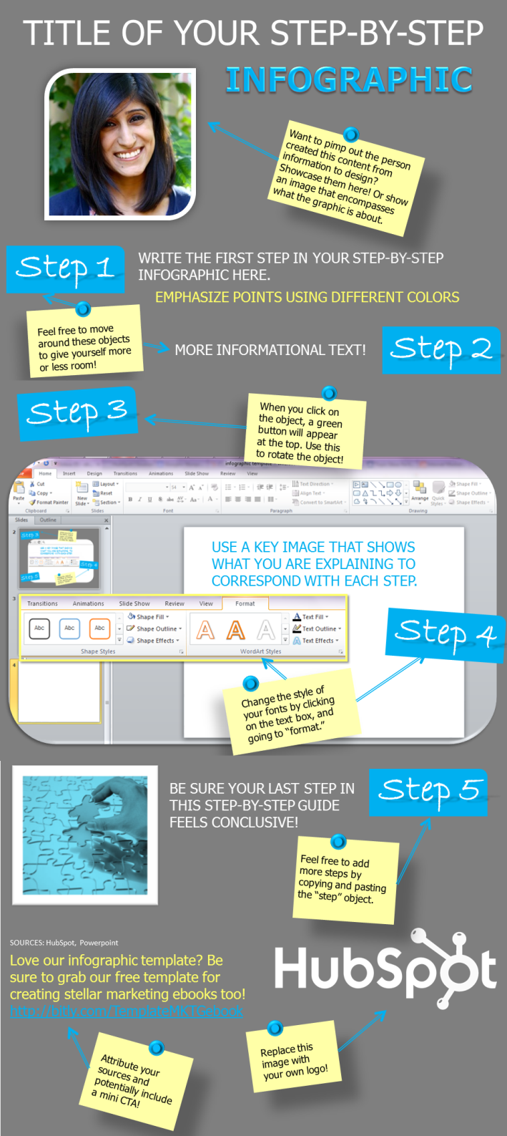
TEMPLATE
1
Step-by-Step Infographic Template
Your content should benefit your audience – that’s a basic inbound marketing principle. But instead of using your normal method of teaching, why not try visualizing the process in a step-by-step infographic? This will help attract more people to your site and tell a story in a creative way.

Slide 6

TITLE OF YOUR STEP-BY-STEP
INFOGRAPHIC
Want to pimp out the person who created this content from information to design? Showcase them here! Or show an image that encompasses what the graphic is about.
Step 1
WRITE THE FIRST STEP IN YOUR STEP-BY-STEP INFOGRAPHIC HERE.
EMPHASIZE POINTS USING DIFFERENT COLORS
Feel free to move around these objects to give yourself more or less room.
Step 2
MORE INFORMATIONAL TEXT

Slide 7

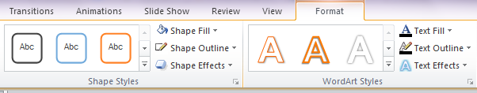
Step 3
When you click on the object, a green button will appear at the top. Use this to rotate the object.
USE A KEY IMAGE THAT SHOWS WHAT YOU ARE EXPLAINING TO CORRESPOND WITH EACH STEP.
Step 4
Change the style of your fonts by clicking on the text box, and going to “format.”

Slide 8


Step 5
BE SURE YOUR LAST STEP IN THIS STEP-BY-STEP GUIDE FEELS CONCLUSIVE.
Feel free to add more steps by copying and pasting the “step” object.
SOURCES: HubSpot, Powerpoint
Attribute your sources when you use quotes, images and data.
Replace this image with your own logo.
Love our infographic template? Be sure to grab our free template for creating stellar marketing ebooks too! http://bitly.com/TemplateMKTGebook
Consider including a call-to-action.

Slide 9
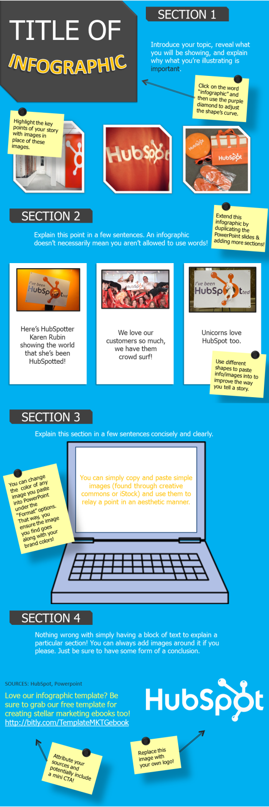
TEMPLATE
2
Informational Infographic Template
Over time, you’ve likely accumulated a lot of information. It might be expertise on a certain subject or simply a blog post that performed well for your company.
Try transforming that information into a visual form and bring it to life once more. You’ll be surprised at how receptive people are to infographics.

Slide 10
SECTION 1
TITLE OF
Introduce your topic, reveal what you will be showing, and explain why what you’re illustrating is important.
INFOGRAPHIC
Click on the word “infographic” and then use the purple diamond to adjust the shape’s curve.
Highlight the key points of your story with images in place of these images.

Slide 11



SECTION 2
Extend this infographic by duplicating the PowerPoint slides & adding more sections.
Explain this point in a few sentences. An infographic doesn’t necessarily mean you aren’t allowed to use words.
Here’s HubSpotter Karen Rubin showing the world that she’s been HubSpotted.
We love our customers so much, we have them crowd surf!
Unicorns love HubSpot too.
Use different shapes to paste info/images into to improve the way you tell a story.

Slide 12

SECTION 3
Explain this section in a few sentences concisely and clearly.
You can simply copy and paste simple images (found through creative commons or iStock) and use them to relay a point in an aesthetic manner.
You can change the color of any image you paste into PowerPoint under the “Format” options. That way, you ensure the image you find goes along with your brand colors.

Slide 13

SECTION 4
Nothing wrong with simply having a block of text to explain a particular section! You can always add images around it if you please. Just be sure to have some form of a conclusion.
Love our infographic template? Be sure to grab our free social media publishing calendar! http://bitly.com/SMPubTemplate
Replace this image with your own logo.
Potentially include a mini CTA.

Slide 14
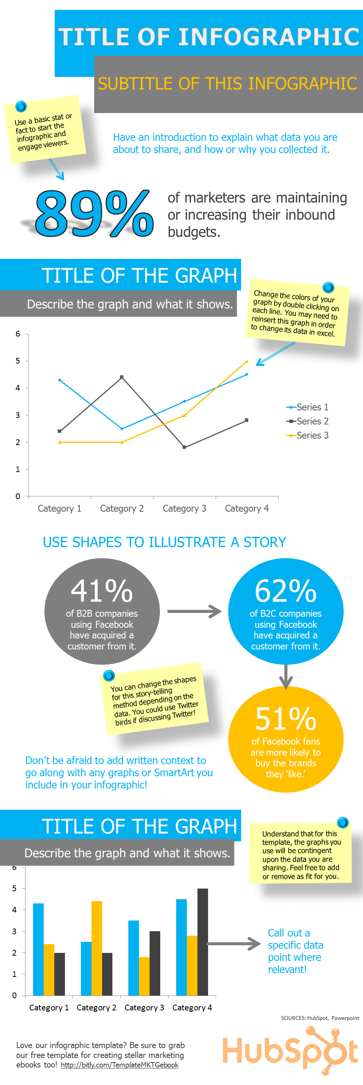
TEMPLATE
3
Data-Packed Infographic Template
Ah yes, numbers. Data is immensely important in not only quantitative decisions, but in emphasizing the importance (or irrelevance) of certain practices and/or behaviors.
But sometimes it’s hard to present and message those statistics. Try putting all that data into an infographic and truly illustrate the power behind those numbers.

Slide 15
TITLE OF INFOGRAPHIC
SUBTITLE OF THIS INFOGRAPHIC
Use a basic stat or fact to start the infographic and engage viewers.
Have an introduction to explain what data you are about to share, and how or why you collected it.
89%
of marketers are maintaining or increasing their inbound budgets.

Slide 16
TITLE OF THE GRAPH
Describe the graph and what it shows.
Change the colors of your graph by double clicking on each line. You may need to reinsert this graph in order to change its data in excel.
Be sure to add source attributions for all data you use.

Slide 17
USE SHAPES TO ILLUSTRATE A STORY
41%
of B2B companies using Facebook have acquired a customer from it.
62%
of B2C companies using Facebook have acquired a customer from it.
You can change the shapes for this story-telling method depending on the data. You could use Twitter birds if discussing Twitter.
51%
of Facebook fans are more likely to buy the brands they ‘like.’
Don’t be afraid to add written context to go along with any graphs or SmartArt you include in your infographic.

Slide 18

TITLE OF THE GRAPH
Understand that for this template, the graphs you use will be contingent upon the data you are sharing. Feel free to add or remove as fit for you.
Describe the graph and what it shows.
Call out a specific data point where relevant.
SOURCES: HubSpot, Powerpoint
Love our infographic template? Be sure to grab our free template for calculating your leads and traffic goals! http://bitly.com/TrafficLeadsCalc

Slide 19

CONNECTING THE SLIDES
Save Slides as Images
Once your infographic is ready, you’ll need to save the PowerPoint slides as images. Simply go to File→ Save As and select PNG (Portable Network Graphics). This is critical as PNG
is the ONLY file type that will give your
infographics the high quality they need
for publishing.
Go to Free Online Tool
Your slides will be saved in a separate folder. After you save your slides as PNG, go to your browser and navigate to http://pixlr.com/editor/. Here, select the option to “Open Image from Computer.” Find your saved folder from Step 1, and select the first slide (the very top of your infographic), and open.

Slide 20
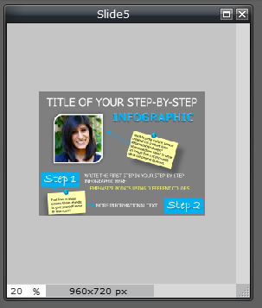
Change the Zoom and Size
Adjust your zoom in the bottom left-hand corner
to 20%. Then in the top navigation bar, go to
Image → Canvas Size. Under canvas size, extend
the Height to 4000. This will allow your canvas to
be large enough to paste in each slide from your
PowerPoint to build the infographic. You can
increase this Height number when needed.
Copy and Paste
Now all you have to do is open the rest of your slides saved as PNG’s by going to File → Open. Use Control-A to select the entire slide, then hit Edit→ Copy. Then go to your image with the increased Height, and paste! You can move around the image to ensure all the pieces are lining up correctly.

Slide 21
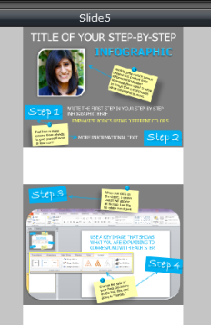
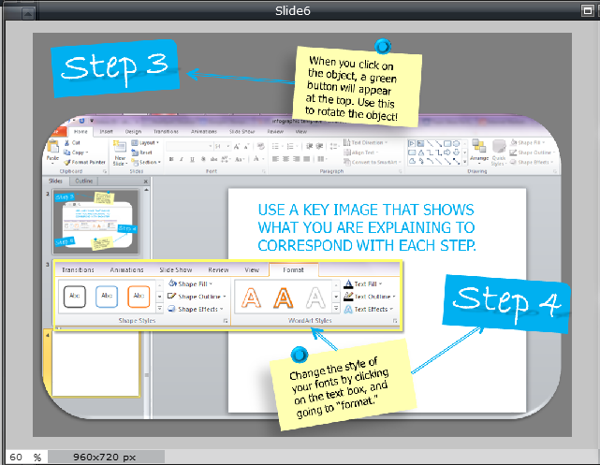
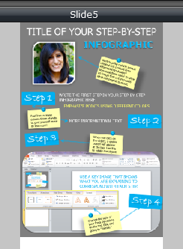

Slide 22
Repeat
Continue to copy and paste your slides until your entire infographic is pieced together! Once you’re done, you can use the crop tool in the toolbar to crop the infographic and eliminate any extra white space added by adjusting the canvas height in step two.
Save as PNG
When you’re done, you once again need to ensure you save the file in PNG format to ensure optimal visual quality. And voila! You have an infographic.
CAUTION: Once you exit your tab on this free online tool, all your content will be lost. Your browser does not save any content, so be sure to save everything as you go.

Slide 23
CONCLUSION
Infographics perfectly fit into your inbound marketing strategy. These appealing visuals attract more internet browsers than regular content, helping expand the visibility of your brand by providing a valuable piece of content. Infographics can spread across the Internet fast, allowing more and more people to see the benefit your company can provide, or at least warm them up to your brand.
And now that you’ve learned how to create and piece together infographics in PowerPoint, it’s time to share them! Use these creative pieces of content as awesome social collateral. Pin them, tweet them, share them. You should also draft a blog post about the infographic. Have a brief introduction that provides further detail about the infographic, and then paste it into the post for viewers to peruse through. Voila! Finished ☺

Slide 24
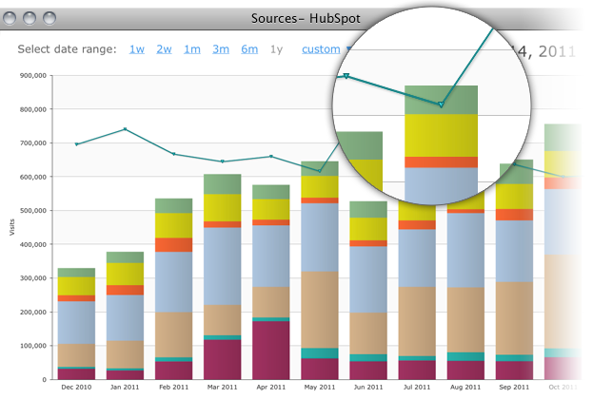
WANT TO MEASURE THE
ROI OF ALL YOUR CONTENT?
Try HubSpot’s marketing software for free.
http://bitly.com/InfographFreeTrial

