Slide 1


Customer
Journey Map Template
Notes:
Title Slide
Dark

Slide 2

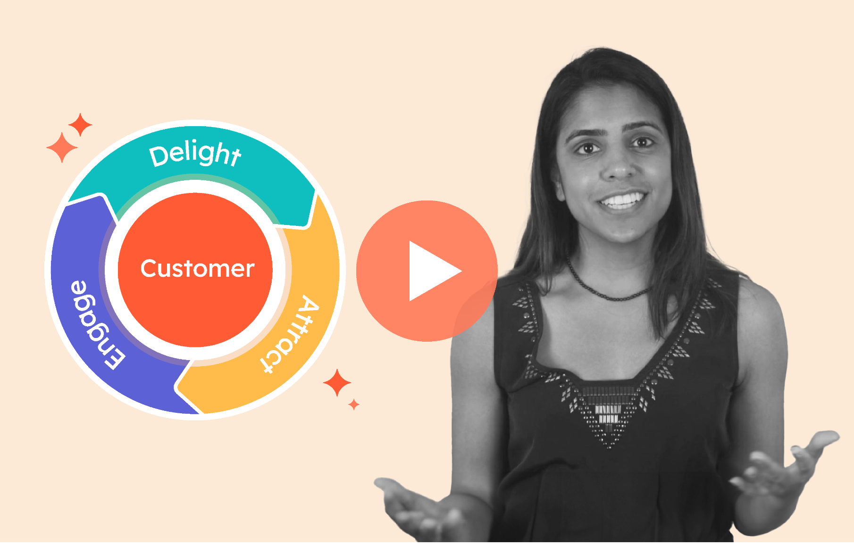
Featured Resource: Creating a Customer Journey Map
Want to learn more? HubSpot Academy offers a free lesson on creating customer journey maps.
Completing this lesson will help you:
Better understand your customers
Improve the customer experience
Get Started Free
Notes:
Product Screenshot Full MacBook

Slide 3

How to Use This Template:
Thanks for downloading this resource.
Included in this resource are seven different customer journey maps, including:
Buyer's Journey Template
Current State Template
Lead Nurturing Mapping Template
Future State Template
A Day in the Customer's Life Template
Customer Churn Mapping Template
Customer Support Blueprint Template
[Prompts in Brackets]: These are intended for you to erase and fill in with information for your specific project, such as project name or a due date.
Once you’re ready to begin, delete the first three slides and start filling out your info below. Remember, you can add/edit/delete any wording or sections you see fit for your projects.
Notes:
Please watch all videos above.

Slide 4



7 Free Customer Journey Map Templates
Customer
Journey Map

Slide 5
Customer Journey: Buyer’s Journey | Awareness Stage | Consideration Stage | Decision Stage
What is the customer thinking or feeling? | [Your info here] | [Your info here] | [Your info here]
What is the customer’s action? | [Your info here] | [Your info here] | [Your info here]
What or where is the buyer researching? | [Your info here] | [Your info here] | [Your info here]
How will we move the buyer along his or her journey with us in mind? | [Your info here] | [Your info here] | [Your info here]

Slide 6
Customer Journey: Current State | Step 1 | Step 2 | Step 3 | Step 4 | Step 5
What is the customer thinking or feeling? | [Your info here] | [Your info here] | [Your info here] | [Your info here] | [Your info here]
What is the customer’s action? | [Your info here] | [Your info here] | [Your info here] | [Your info here] | [Your info here]
What is the customer’s touchpoint with the business? | [Your info here] | [Your info here] | [Your info here] | [Your info here] | [Your info here]
What do we want to change about this step? | [Your info here] | [Your info here] | [Your info here] | [Your info here] | [Your info here]
How and/or why will we make this change? | [Your info here] | [Your info here] | [Your info here] | [Your info here] | [Your info here]

Slide 7
Customer Journey: Lead Nurturing | Stranger | Subscriber / Lead | MQL | Opportunity / Demo | Deal Closed to Go-Live/Handoff
What is the lead thinking, feeling, or doing? | [Your info here] | [Your info here] | [Your info here] | [Your info here] | [Your info here]
Who from our company is the lead hearing from or talking to? | [Your info here] | [Your info here] | [Your info here] | [Your info here] | [Your info here]
What content from our company is the lead interacting with? | [Your info here] | [Your info here] | [Your info here] | [Your info here] | [Your info here]
What can we do to expedite this process? | [Your info here] | [Your info here] | [Your info here] | [Your info here] | [Your info here]
What can we do to make the lead more comfortable in decision making? | [Your info here] | [Your info here] | [Your info here] | [Your info here] | [Your info here]

Slide 8
Customer Journey: Future State | Step 1 | Step 2 | Step 3 | Step 4 | Step 5
What is the customer thinking or feeling? | [Your info here] | [Your info here] | [Your info here] | [Your info here] | [Your info here]
What is the customer’s action? | [Your info here] | [Your info here] | [Your info here] | [Your info here] | [Your info here]
What is the customer’s touchpoint with the business? | [Your info here] | [Your info here] | [Your info here] | [Your info here] | [Your info here]
How does the above section differ than the current or previous state? | [Your info here] | [Your info here] | [Your info here] | [Your info here] | [Your info here]
Why do we feel this will alter the customer journey? | [Your info here] | [Your info here] | [Your info here] | [Your info here] | [Your info here]

Slide 9
Customer Journey: A Day in the Life | Early Morning | Late Morning | Afternoon | Evening | Nighttime
What is the customer thinking or feeling? | [Your info here] | [Your info here] | [Your info here] | [Your info here] | [Your info here]
What are the customer’s actions or main priorities? | [Your info here] | [Your info here] | [Your info here] | [Your info here] | [Your info here]
What are the customer’s biggest pain points at this time? | [Your info here] | [Your info here] | [Your info here] | [Your info here] | [Your info here]
How does the customer interact with our product at this time? | [Your info here] | [Your info here] | [Your info here] | [Your info here] | [Your info here]
How can our product be better utilized at this time? | [Your info here] | [Your info here] | [Your info here] | [Your info here] | [Your info here]

Slide 10
Customer Journey: Customer Churn | Popular Churn Reason #1 | Popular Churn Reason #2 | Popular Churn Reason #3 | Popular Churn Reason #4 | Popular Churn Reason #5
What did the customer experience? | [Your info here] | [Your info here] | [Your info here] | [Your info here] | [Your info here]
What is the customer feeling after this/these incidents? | [Your info here] | [Your info here] | [Your info here] | [Your info here] | [Your info here]
Why does this ultimately cause the customer to churn? | [Your info here] | [Your info here] | [Your info here] | [Your info here] | [Your info here]
How can we improve this experience to reduce churn? | [Your info here] | [Your info here] | [Your info here] | [Your info here] | [Your info here]

Slide 11
Customer Journey: Service & Support | Normal Use | Notices Issue or Has Complaint | Asks for Help / Contacts Support | Speaks with Support or Rep | Resolves Conflict / Issue
What is the customer feeling? | [Your info here] | [Your info here] | [Your info here] | [Your info here] | [Your info here]
Why is the customer feeling this way? | [Your info here] | [Your info here] | [Your info here] | [Your info here] | [Your info here]
How do we communicate with the customer? | [Your info here] | [Your info here] | [Your info here] | [Your info here] | [Your info here]
What action do we take in the background? | [Your info here] | [Your info here] | [Your info here] | [Your info here] | [Your info here]

Slide 12





How’d we do? If you have a minute, we’d appreciate you taking our four-question survey to help us make better content like this in the future. Give us your feedback.

